Slide 1
Blockchain Based Management for Organ Donation and Transplantation
Team Details
A.Naresh (21EG505801)
K.Sai Achyuth (21EG505839)
Vaseema Samreen (21EG505867)
Project Supervisor
J. Himabindu Priyanka
Assistant Professor

Slide 2
Introduction
The modern landscape of organ donation and transplantation systems is characterized by a complex interplay of legal, clinical, ethical, and technical challenges. Addressing the intricate requirements of registration, donor-recipient matching, organ removal, delivery, and transplantation while ensuring fairness and efficiency is paramount. In response to these challenges, this paper introduces a solution: a private Ethereum blockchain-based system designed to revolutionize organ donation and transplantation management. By embracing decentralization, security, traceability, auditability, privacy, and trustworthiness, the proposed solution utilizes smart contracts and implements algorithms to facilitate a comprehensive end-to-end process. This paper meticulously details the development, testing, and validation of these smart contracts, assessing the performance of the system through privacy, security, and confidentiality analyses.

Slide 3
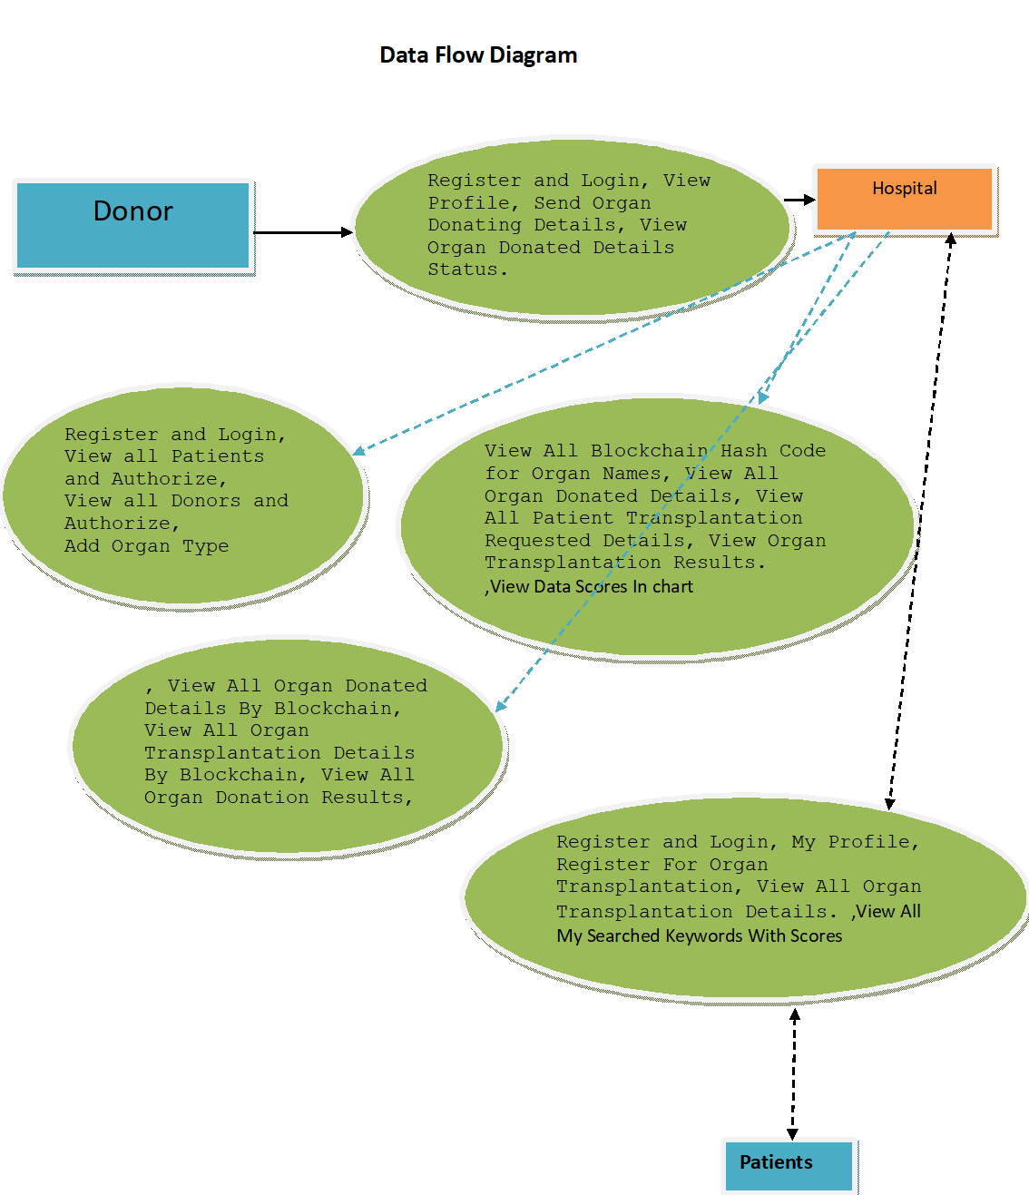
Concept Tree

Slide 4
Literature Survey
Author(s) | Strategies | Advantages | Disadvantages
L. A. Dajim, S. A. Al-Farras, B. S. Al-Shahrani, A. A. Al-Zuraib, and R. Merlin Mathew | It would be a web application for patients to register their information-most importantly medical ID, blood type, organ type and state. | Decentralized app First-in, first-out basis unless a patient is in critical condition. | Blockchain Scalability Issues Data Privacy Concerns
M. He, A. Corson, J. Russo, and T. Trey | Use of forensic DNA testing to trace unethical organ procurement and organ trafficking practices in regions that block transparent access to their transplant data. | Addressing Lack of Transparency International Collaboration | Ethical and Privacy Concerns Legal Challenges.

Slide 5
Author(s) | Strategies | Advantages | Disadvantages
P. Ranjan, S. Srivastava, V. Gupta, S. Tapaswi, and N. Kumar | This paper presents a decentralised, secure and transparent organ and tissue transplant web application which not only nullifies the role of any third party involved in the organ transplantation. | Decentralization Transparency | Scalability Cost of Implementation
M. Hölbl, M. Kompara, A. Kamišalić, and L. N. Zlatolas. | The potential of blockchain technology in the healthcare sector, particularly in addressing the challenges associated with Electronic Health Records (EHRs) | Security and Trust Privacy Enhancement | Storage Challenges Complexity in Implementation

Slide 6
Problem Statement
Current organ donation systems face challenges in registration, matching donors to recipients, andensuring a fair, efficient, and trustworthy process. To address these issues, this paper proposes a decentralized, secure, and transparent solution using a private Ethereum blockchain. The aim is to enhance organ donation and transplantation management by implementing smart contracts and algorithms, ensuring security, traceability, and privacy throughout the process.
Existing Method(s) Disadvantages:
The system is not implemented blockchain based organ donation which leads less security and less communication between hospitals and donors..
The system is not implemented an auto-matching process between the donor and recipient through a smart contract based on certain criteria.

Slide 7
Problem Illustration
The current organ donation and transplantation systems face challenges such as inefficient registration, delayed matching, and security concerns. To address these issues, a proposed solution suggests a private Ethereum blockchain-based approach. This decentralized system aims to enhance security, traceability, and fairness through smart contracts and algorithms. The solution undergoes rigorous evaluation, including privacy and security analyses, and is compared to existing alternatives.

Slide 8
Proposed Method
The system proposes a decentralized and secure organ donation and transplantation management solution using a private Ethereum blockchain.
Smart contracts register actors, ensuring data provenance. The system automates donor-recipient matching through smart contracts and presents implemented algorithms.
A security analysis demonstrates resilience against common attacks, and a comparative evaluation underscores the solution's novelty.
The system's adaptability makes it versatile for various related applications.

Slide 9
Proposed Method Illustration
The proposed method leverages a private Ethereumblockchain for organ donation and transplantation management. Smart contracts play a pivotal role by registering actors and meticulously recording data provenance.The auto-matching process, powered by smart contracts, streamlines donor-recipient pairing based on predefined criteria. Additionally, algorithms are introduced, showcasing their full implementation, testing, and validation. A thorough security analysis confirms the system's resilience against common threats, and a comparative assessment highlights its innovative features. The solution's adaptability further reinforces its potential for diverse applications in the organ donation domain.

Slide 10
Parameters:-
Security- Providing security to the application
Time management- Faster execution
Smart Contracts- Code generation

Slide 11
Experiment Environment
Operating System - Windows
Coding Language - Java/J2EE(JSP,Servlet)
Front End - J2EE
Back End - MySQL

Slide 12
Project status
S.No | Functionality | Status (Completed /in-progress/Not started)
1 | Functionality | Completed
2 | Research Paper Collection | Completed
3 | Code Implementation testing and training | in-progress
4 | Documentation | in-progress

Slide 13
References:-
[1] L. A. Dajim, S. A. Al-Farras, B. S. Al-Shahrani, A. A. Al-Zuraib,
and R. Merlin Mathew, ``Organ donation decentralized application using
blockchain technology,'' in Proc. 2nd Int. Conf. Comput. Appl. Inf. Secur.
(ICCAIS), May 2019, pp. 14, doi: 10.1109/cais.2019.8769459.
[2] A. Powell. (Mar. 18, 2019). A Transplant Makes History. Harvard Gazette.
https://news.harvard.edu/gazette/story/2011/09/atransplant-makes-history/
[3] Organ Donation Facts and Info: Organ Transplants. Accessed:
Apr. 18, 2021.
https://my.clevelandclinic.org/health/articles/11750-organ-donation-and-transplantation

Slide 14
Thank you

